Slide 1
CPSC-4345 Database Systems Final Presentation
Justin Colwell-Ongenae, Dan Paz, Gytis Grabauskas

Slide 2
Blind Grading System for Ethical Law School
Ethical Law School would like to remove all bias between professors and student exams. In order to achieve this there needs to be a layer of abstraction between exam attempts and the student name/ID numbers that took those exams. The faculty will then grade submissions not knowing who the student was and therefore be unable to channel any subconscious bias when grading. The database contains data about students, exams, and courses. The database used is MySQL and the application will be built on the Laravel framework for PHP.
Notes:
Justin: In short: Creating a system for Professors to assign the final course grade to students while preventing any conscious or unconscious bias based on student’s name.

Slide 3
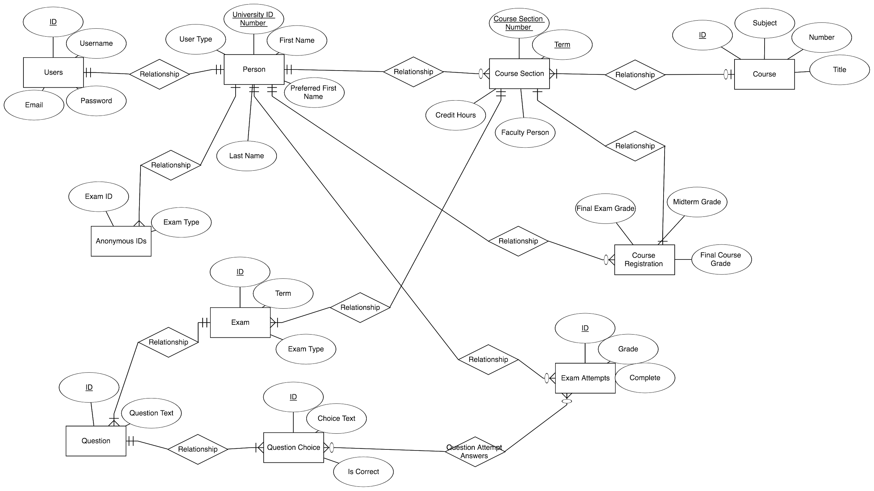
ER Diagram
Notes:
Dan: During conception we came up with a total to entities that needed to be created in order to support the system. The most important entities being Users, Person, and Anonymous IDs.

Slide 4
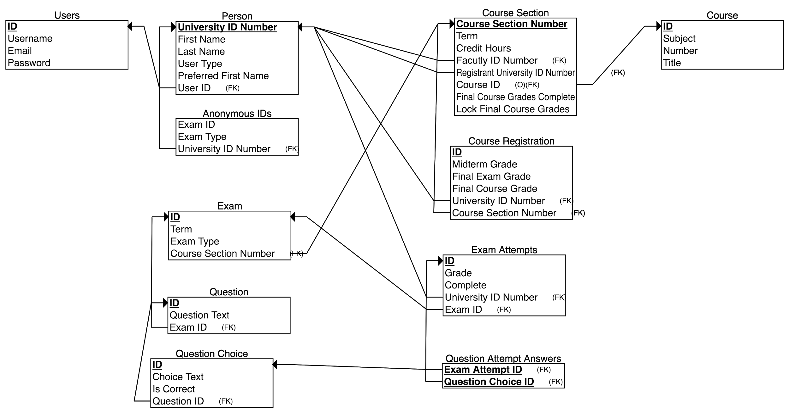
Relational Schema
Notes:
Gytis: From the entities, we generated a relational schema using ERDplus.com It was mostly good, but still required some additional cleanup. This table is the end result.
It all starts with the user table, which has the account information for the user, and has a relationship with the Person Table User ID.
The University ID has relationships with the Course Sections, Course registrations, anonymous ID’s and the Exam Attempts
The Course Section Table contains all of the information for a specific course, at a specific term. And has a relationship with the exams that are related to the Course Section Number, as well as a relationship with the course registration, for when students are picking their classes.
Moving on, the Exam Table has a Foreign Key for the course section number which is used to identify which courses exam the student is taking.
The Question Table pulls the questions for the exam using the Exam ID Foreign Key, and the Question Choice table also pulls the answers by using the Question ID Foreign Key.
Lastly, the Question Attempt Answers Table is an intersection table, that joins all exam attempts with the answers chosen by the student on each exam.

Slide 5
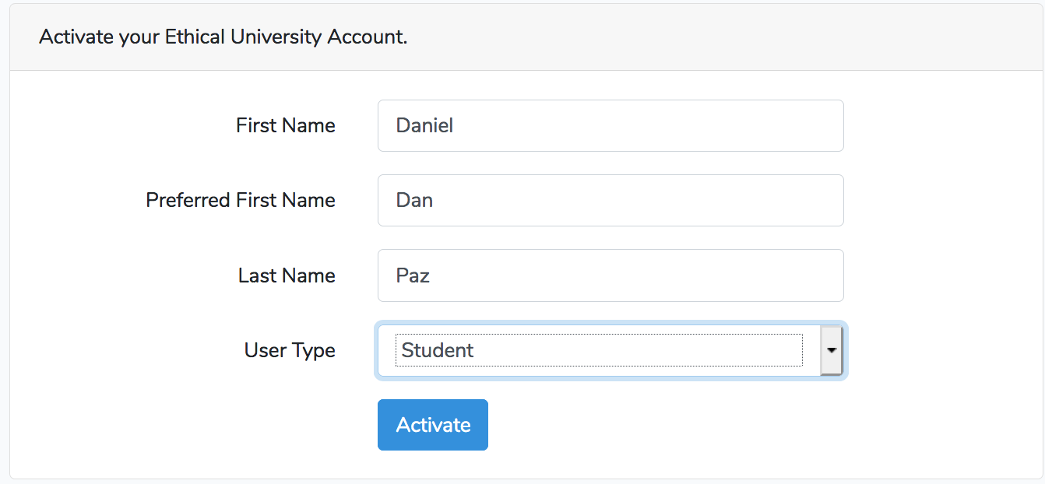
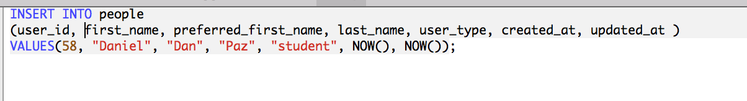
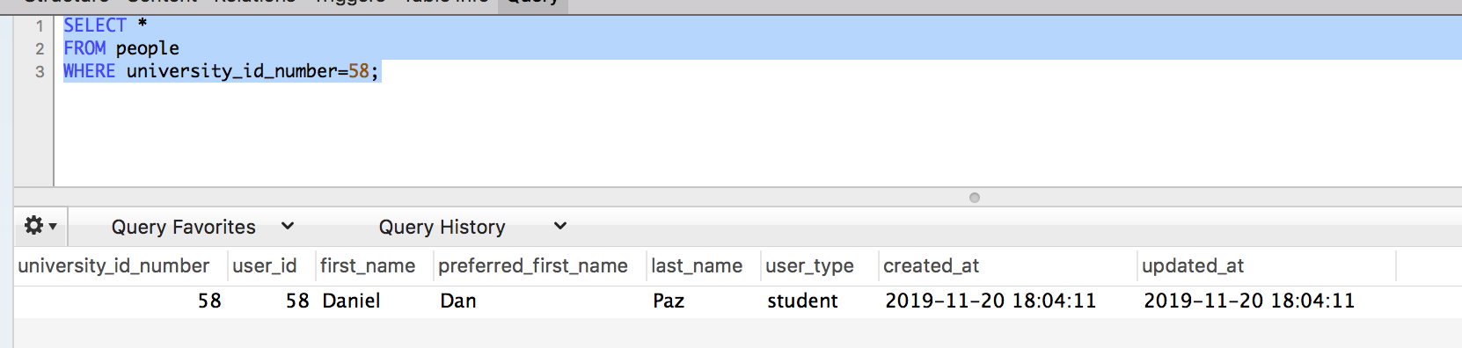
Creating a Person
Notes:
Justin: Here is an example of creating a person, it starts with adding data on a form. On the back end an Insert query is made and then the record is confirmed by running a select query.

Slide 6
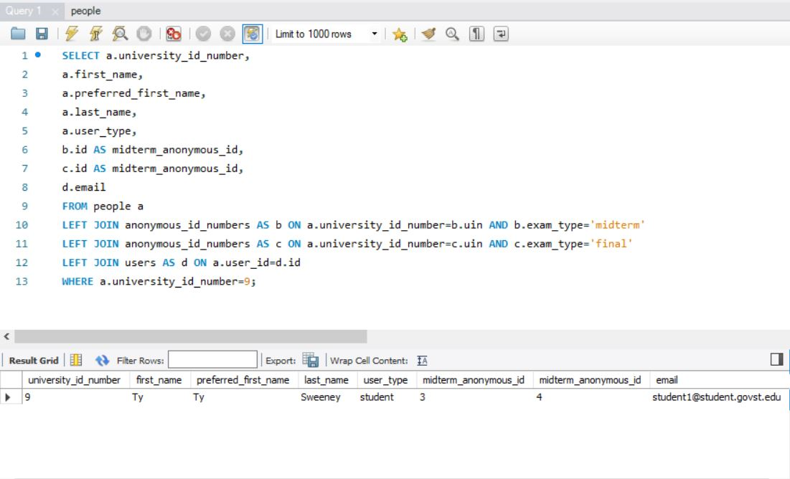
Student Profile Query (mySQL View)
Notes:
Justin: Query used to to display a student’s information.

Slide 7
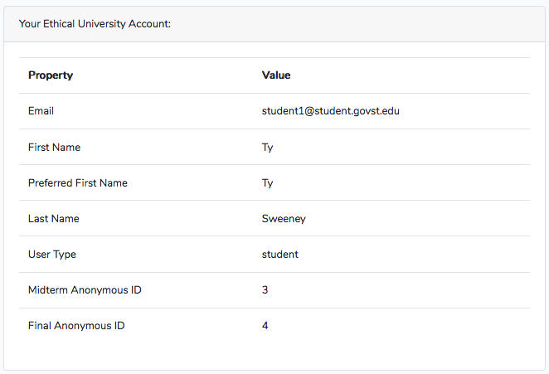
Student Profile Query (Front End View)
Notes:
Justin: Page Rendering of the student display information

Slide 8
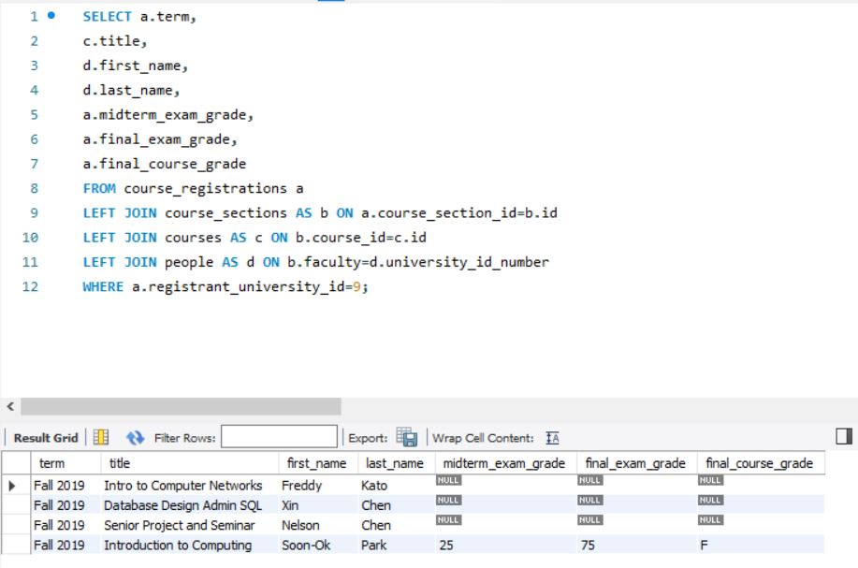
Student Registered Courses and Grades (mySQL View)
Notes:
Gytis: Query used to grab all registrations for a specific student ID.

Slide 9
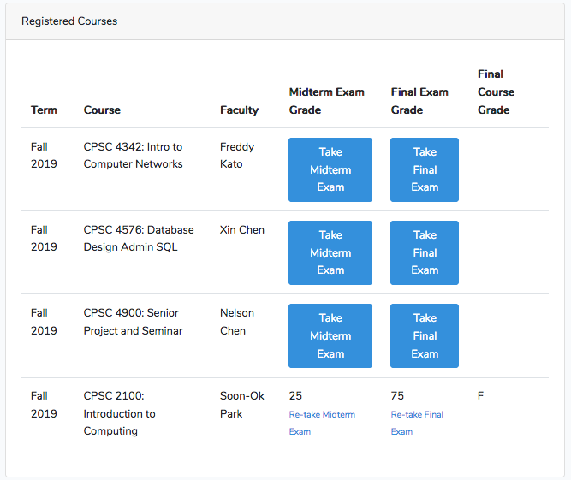
Student Registered Courses and Grades(Front End View)
Notes:
Gytis: Display of student registrations from previous query.

Slide 10
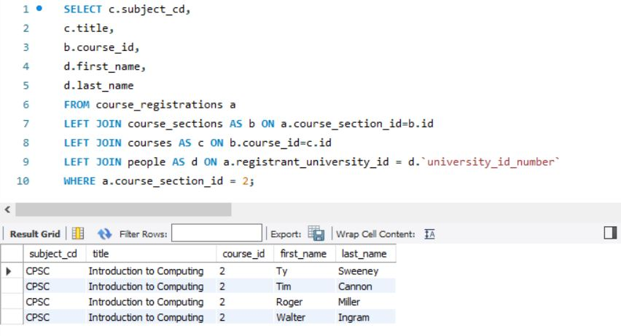
Faculty Roster Query (mySQL View)
Notes:
Dan: Query used to grab a roster for a specific course section.

Slide 11
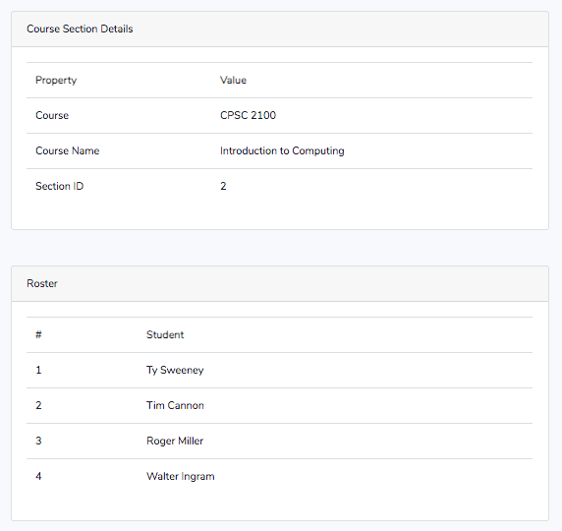
Faculty Roster Query (Front End View)
Notes:
Dan: Display of roster for a specific section from previous query.

Slide 12
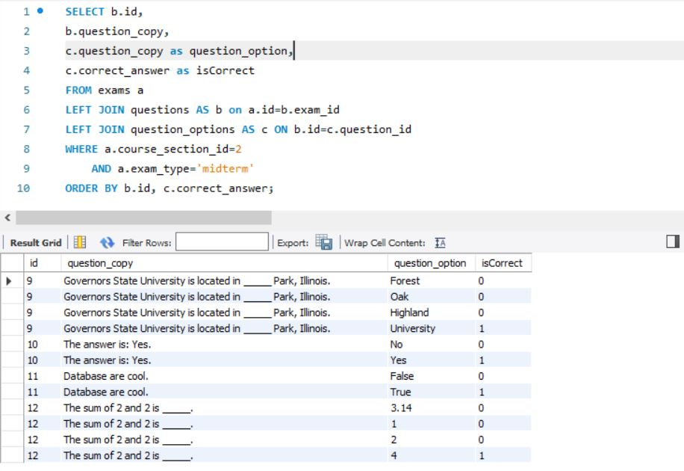
Student Mid Term Exam Query (mySQL View)
Notes:
Justin: Query used to grab all of the questions for an exam in a specified course section.

Slide 13
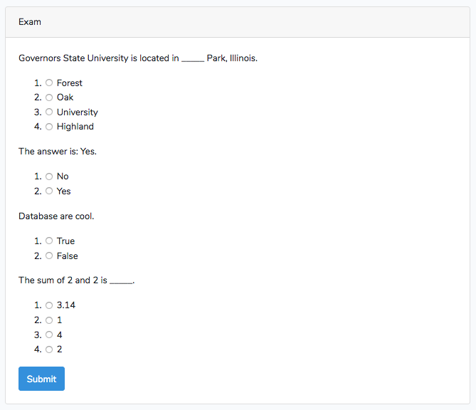
Student Mid Term Exam Query (Front End View)
Notes:
Justin: Rendering of the query from previous slide.

Slide 14
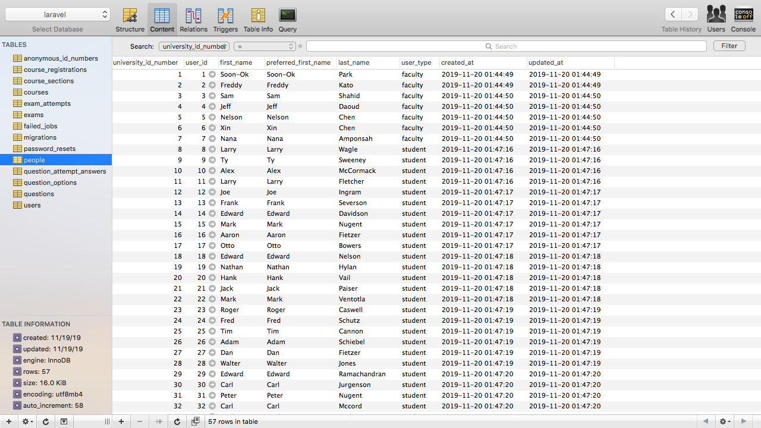
User Profiles Table
Notes:
Dan: One example of the 10+ tables used by the application.

Slide 15
Documentation
Source code: https://github.com/soundzofstatic/cpsc_4345_project
ReadMe (documentation): https://github.com/soundzofstatic/cpsc_4345_project/blob/master/ReadMe.md
Demo: http://0.0.0.0:8090/
Notes:
Source code: https://github.com/soundzofstatic/cpsc_4345_project
ReadMe (documentation): https://github.com/soundzofstatic/cpsc_4345_project/blob/master/ReadMe.md
Demo: http://0.0.0.0:8090/

